Slide 1

Causal Inference in Machine Learning
1
Notes:
1

Slide 2
What is causality
2
Notes:
2

Slide 3
Overview
3
Notes:
3

Slide 4
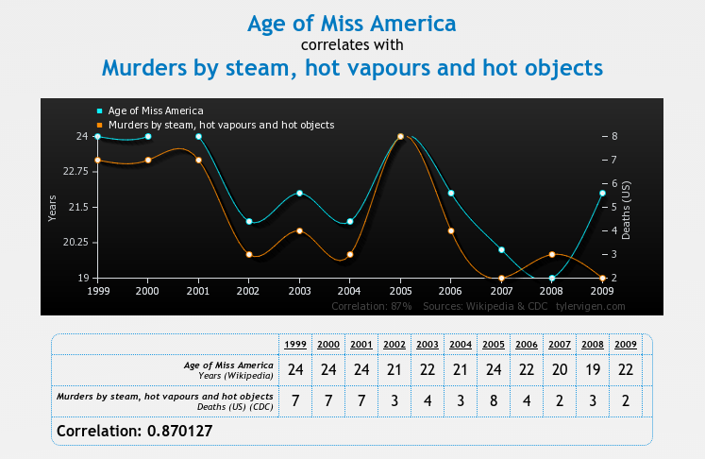
Correlation and Causation
Image source: www.tylervigen.com/
4
Notes:
4

Slide 5
Why do we care?
5
Notes:
5

Slide 6
Approaches to learning to act
Reinforcement Learning - Just do it!
Observational Causal Inference
6
Notes:
6
Sometimes intervention is very costly – or impossible to do at an individual level (eg raise ban on alcohol sales to 21 for every 2nd person.
In many cases there are just two many possible options to explore.
A lot of data collected for other purposes

Slide 7
Observational causal inference
7
Notes:
7

Slide 8
Causal Bayesian Networks
Truncated product formula: drop terms for intervened variables from the factorisation.
A CBN represents the set of all possible interventional distributions over its variables
8
Notes:
8
high light what remains invariant

Slide 9
The do calculus (simplified)
9
Notes:
9
Things are more interesting when there are latent variables
The do notation is just a notation – the question is can properties of one system be inferred from another.
Explain the localisation property of d-separation.
The do calculus is complete

Slide 10
Identifiability
10
Notes:
10
Things are more interesting when there are latent variables
The do notation is just a notation – the question is can properties of one system be inferred from another.
Explain the localisation property of d-separation.
The do calculus is complete

Slide 11
Inference from observational data – aka Pearl
11
Notes:
11

Slide 12
Can’t we just be Bayesian?
12
Notes:
12

Slide 13
Careful with that prior
The goal is to estimate the causal effect of X on Y
It is indefinable via the do-calculus
OLS is unbiased
13
Notes:
13

Slide 14
Pesky statistical issues
14
Notes:
14

Slide 15
What is the objective?
What question do we actually want to answer?
15
Notes:
15

Slide 16
Other causal frameworks
Counterfactuals
Structural equation models
Granger causality
16
Notes:
16

Slide 17

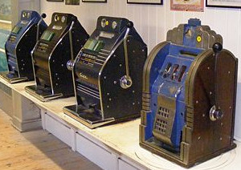
The interventional approach to causality
Randomized trials are the traditional gold standard for determining causality
Bandits?
17
Notes:
17
The key function of randomisation is to break the link with any confounders - the true key is explicit control of actions.
Bandits algorithms also explicitly assign actions and typically utilize randomization – but also account for the sequential nature of decision processes.

Slide 18
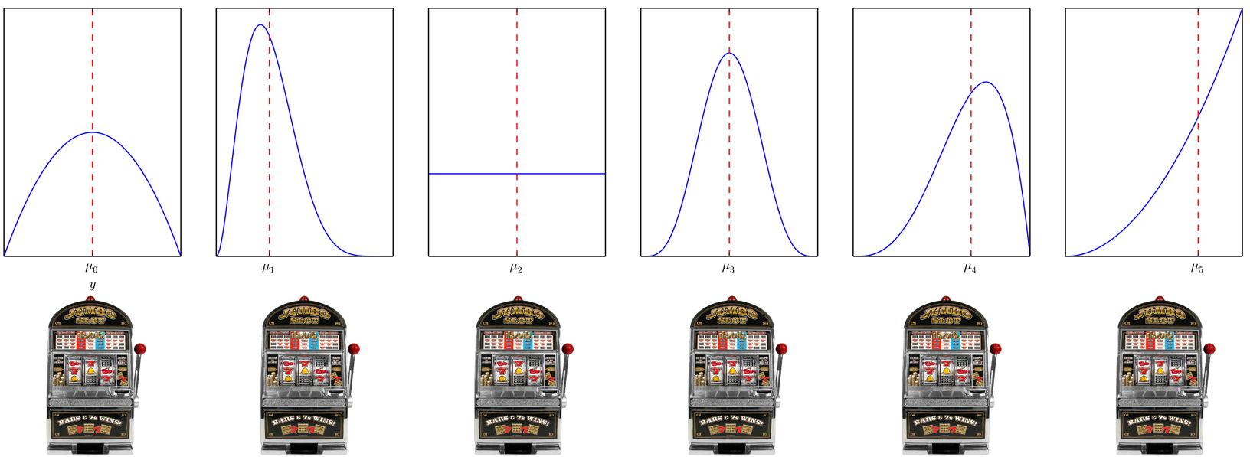
Classic Multi-armed Bandits
18
Notes:
18

Slide 19
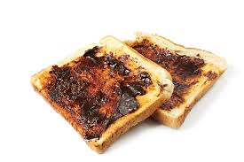

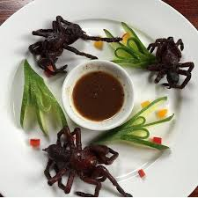
Key Challenges & Approaches
Explore-exploit trade-off
Non i.i.d data
Regret
19
Notes:
19
The goal is not to learn a good estimate for all actions – it is to play suboptimal actions as little as possible
Sublinear (in T) regret means we are learning – the longer the time the better on average our choices.
This is worst-case (or distribution independent regret)
Approaches
UCB (optimism in the face of uncertainty)
Sample from some weighted combination of the actions (Exp3 & Thompson sampling)
Eliminate sub-optimal actions
Bandits are RL with immediate feedback (or single state MDPs)
-
Contrast to uniform exploration (eg A/B test)
Optimal experimental design – (best arm identification is a form of this)

Slide 20



Contextual Bandits
20
Notes:
20
There are many variants of the bandit problem
Adversarial – instead of the environment generating rewards purely stochastically – think of it as an adversary, who knows your algorithm and can try to design the distribution of rewards to thwart you.
Contextual bandits – we can observe some characteristics of the individual before we select an action – the naïve solution (for discrete context) is to run an independent bandit algorithm for each possible value of context.
Off-policy evaluation

Slide 21
Causal structure of contextual bandit problems
Contextual bandit algorithms do not require that the context is a cause of the outcome.
21
Notes:
21

Slide 22
The need for structure
Regret grows linearly with the number of actions
22
Notes:
22
Regret increases linearly with the number of arms (problem dependent regret does) – this is bad when we have exponentially many actions to explore.
Do we really need another flavour of bandit?

Slide 23
Causal Bandit Problems
Every (allowable) assignment of variables to values is a bandit arm.
Reward is value of a single specified node in the graph after the action.
23
Notes:
23

Slide 24
The anatomy of causal bandit problems
24
Notes:
24
How do they relate to existing bandit settings?
Take on characteristics of different settings depending on what is observed and when.

Slide 25
C-Bandit problems with post-action feedback
Problems for which additional feedback available only after action selected (no context).
Focus is on the simple regret
25
Notes:
25
Simple regret arises in best-arm identification or pure-exploration problems – where we can explore without penalisation during some training period and must then identify an optimal arm. It arises in practise in settings in which we can simulate data – or where the overhead of a ‘experimental’ period is high – such that we want to identify the best option during a learning phase and then select that option from then on.
Best-arm identification still has an explore-exploit trade-off – we are still not trying to learn about the rewards of all arms (we only need to learn about plausibly optimal arms) but it’s a subtly different to the one for cumulative regret.

Slide 26
The parallel bandit problem
26
Notes:
26

Slide 27
The parallel bandit problem – algorithm
Observe for first T/2 rounds to estimate reward for actions that occur frequently naturally.
Uniformly explore infrequent actions in remaining rounds.
But how do we define infrequent?
27
Notes:
27
There are m(q) infrequent arms, so T/2m samples for them. The remaining arms also get ~T/2m samples because they occur with probability > 1/m(q) during observe phase.
These definition for m assumes we do some relabelling such that the q_i’s are <= .5 and ordered – does not effect generality.
We do not assume m(q) is known – estimate this from the first T/2 rounds

Slide 28
The parallel bandit problem – regret bounds
Parallel bandit
Standard bandit
28
Notes:
28
See that the approach is order optimal (worst case).

Slide 29
General graphs - challenges
We could map from observation to intervention via the do-calculus but,
Its no longer optimal ignore the information intervening on one variable can provide about another.
29
Notes:
29

Slide 30
General graphs - challenges
30
Notes:
30
The point is that P(X_2 = 1) = 0.5

Slide 31
General graphs - solution
31
Notes:
31
This is a strong assumption – but there are cases in which it is realistic, ie a company may be able to control a range of levers and know how each of these levers impact a number of characteristics of their business – but not how some external quantity might respond.

Slide 32
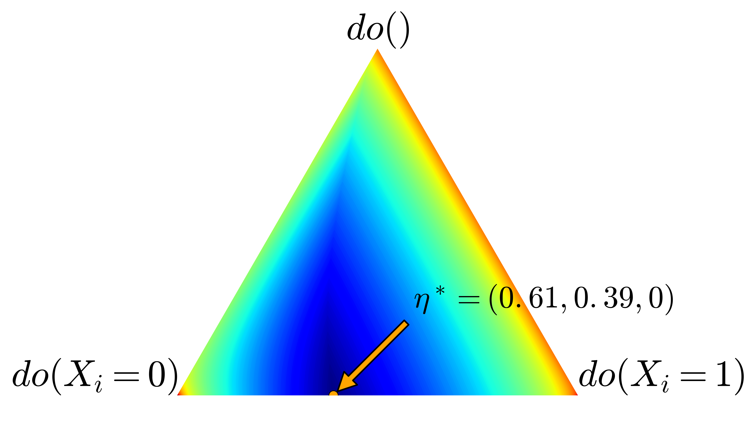
General graphs - solution
32
Notes:
32
m(eta*) is the minimum worst-case variance of the importance weighted estimator – also an effective number of arms.
m(eta*) is 3.8 in this setting.

Slide 33
General graphs - solution
General CB upper bound
Standard lower bound
33
Notes:
33
m(eta*) is the minimum worst-case variance of the importance weighted estimator – also an effective number of arms.

Slide 34
Experiments
34
Notes:
34
m(eta*) is the minimum worst-case variance of the importance weighted estimator – also an effective number of arms.

Slide 35
Quantifying the value of intervention
35
Notes:
35

Slide 36
Summary & Future Work
36
Notes:
36
The optimism principle breaks when we have information sharing across arms.
There is a general principle that could be applied to minimize Bayesian regret – Information direct sampling
Its important to put these two parts together because, from a bandit perspective, structure is needed to make learning how to act feasible in realistic problems with many potential variables to control – and potentially exponentially many actions - and from a observational causal inference perspective because not everything can be learnt from observational data.
Could we use the corelling bandit approach – such that if the assumption is wrong we switch to using the better estimation method?

Slide 37
Questions
37
Notes:
37

Slide 38
A map of the literature
38
Notes:
38

Slide 39
Simpson’s Paradox
39
Notes:
39

